Slide 1
Adversarial example using FGSM

Slide 2
Outline
Introduction
Implementing
Result

Slide 3
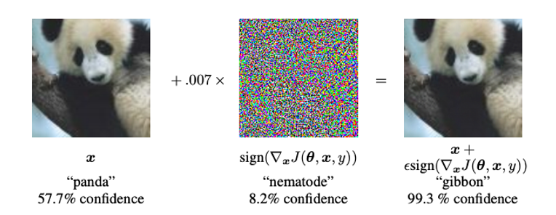
Introduction
Adversarial examples
Special inputs which are confusing a neural network
Indistinguishable to the human eye
Cause the network to fail to identify
Example

Slide 4
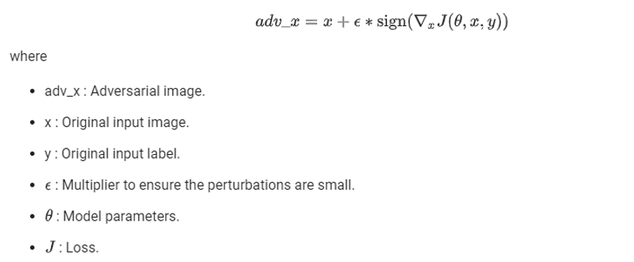
Introduction
Fast gradient sign method
which is a white box attack whose goal is to ensure misclassification
Using the gradients of the loss to maximises the loss
Adversarial image can be summarised using the following

Slide 5
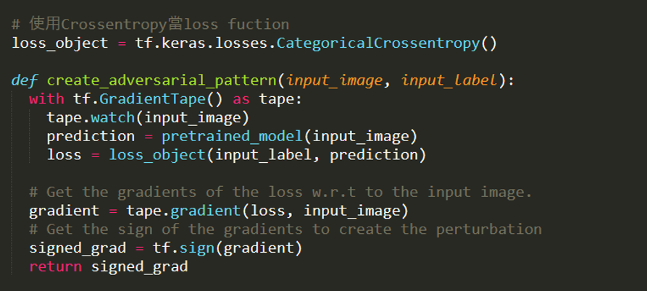
Implementing

Slide 6
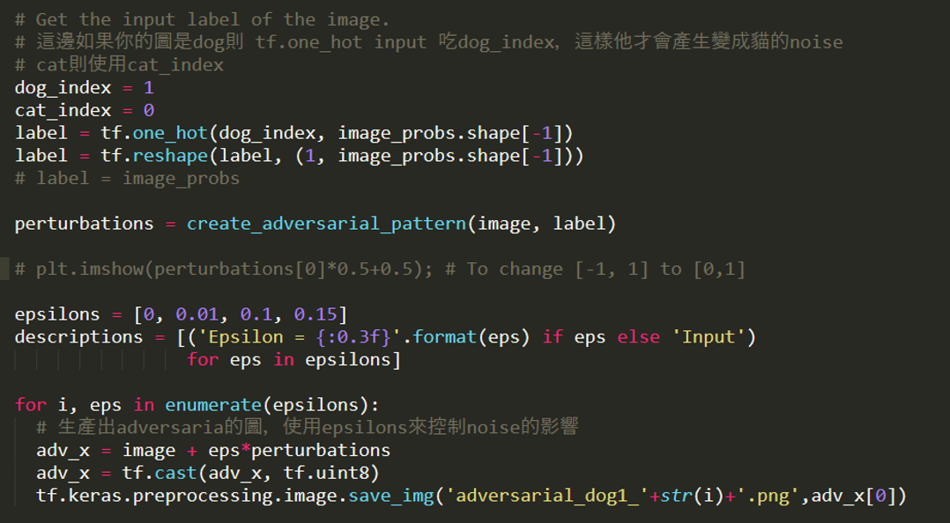
Implementing

Slide 7



Result
$+ ε× =$

Slide 8


Result
$+ ε× =$

Slide 9



Result
$+ ε× =$

Slide 10
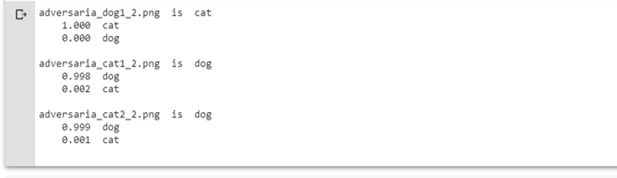
Result

